Slide 1
The Context: Deep Learning, AI and Machine Learning
Mohammed ELAffendi

Slide 2
Foreword
The Context: AI, Machine Learning & Deep Learning
Building and Implementing Deep Learning Models
Python & Keras
Configuration and Model Parameters: Activation Functions, Loss Functions, Optimization, ….etc
Gradient Descent and Backpropagation
Examples of Applying Deep Learning Models to Solve Problems in Different Areas – a repeating task (Seeing is Believing, Doing is Learning)

Slide 3
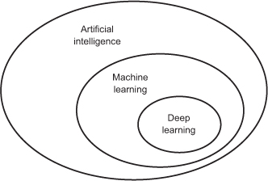
Machine Learning is Subfield of AI

Slide 4
It is not that new – Revival Due to Advances in Technology
Techniques | Year
Neural networks | 1943
Backpropagation | 1962?
Convolutional Neural Networks | 1979
Recurrent Neural Networks | 1980
Long-Short-Term-Memory | 1997

Slide 5
AI, the Parent Field
Born in the 1950’s as an attempt to answer the question: Can Machines Think?
One popular definition of AI : the effort to automate intellectual tasks normally performed by humans.
Traditional symbolic AI is based on the assumption that computers (machines) can achieve human level intelligence by having programmers (developers) hand-craft a large set of rules that manipulate knowledge and conditions (examples: playing chess- Expert Systems- Syntax and Semantic Rules for NLP, Sentiment Analysis)
Accordingly, symbolic AI systems are rule based and rely on human beings to build rule-bases or knowledge bases
Examples are chess playing programs and expert systems

Slide 6
Machine Learning?
In 1843, Ada Lovelace commented on the intelligence of the Mechanical Engine (Computer) invented by Babbage (the first Mechanical Computer) : “The Analytical Engine has no pretensions whatever to originate anything. It can do whatever we know how to order it to perform.... Its province is to assist us in making available what we’re already acquainted with.”
Turing, 1950 commented on Ada objection and concluded that general purpose machines (computers) are capable of learning and originality.
Later, machine learning emerged as an answer to the same Ada objection: could a computer go beyond “what we know how to order it to perform” and learn on its own how to perform a specified task?

Slide 7
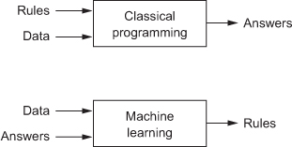
Machine Learning Systems Discover Rules From Data
Machine-learning systems are trained rather than explicitly programmed.
They are presented with many examples and patterns relevant to the problem, and they discover some structures in these examples that makes the system capable of generating rules that automate the solution of the problem and the performance of a general task. For example image recognition.

Slide 8
What is Machine Learning?
Machine Learning is: “searching for useful representations of some input data, within a predefined space of possibilities, using guidance from a feedback signal”.
This simple idea makes it possible to solve a broad range of intellectual tasks, from speech recognition to autonomous car driving.

Slide 9
Deep Learning
a new approach on learning representations from data that puts an emphasis on learning successive layers of increasingly meaningful representations.
Deep learning is a variation and subfield of machine learning where the emphasis is on learning representations using multi-layer neural networks
The word “deep” here refers to the number of hidden (intermediate) layers in the neural network – usually more than two hidden layers indicates a deep network
Another difference from traditional machine learning is that features are extracted by the model, while in machine learning feature extraction is made through some manual tasks

Slide 10
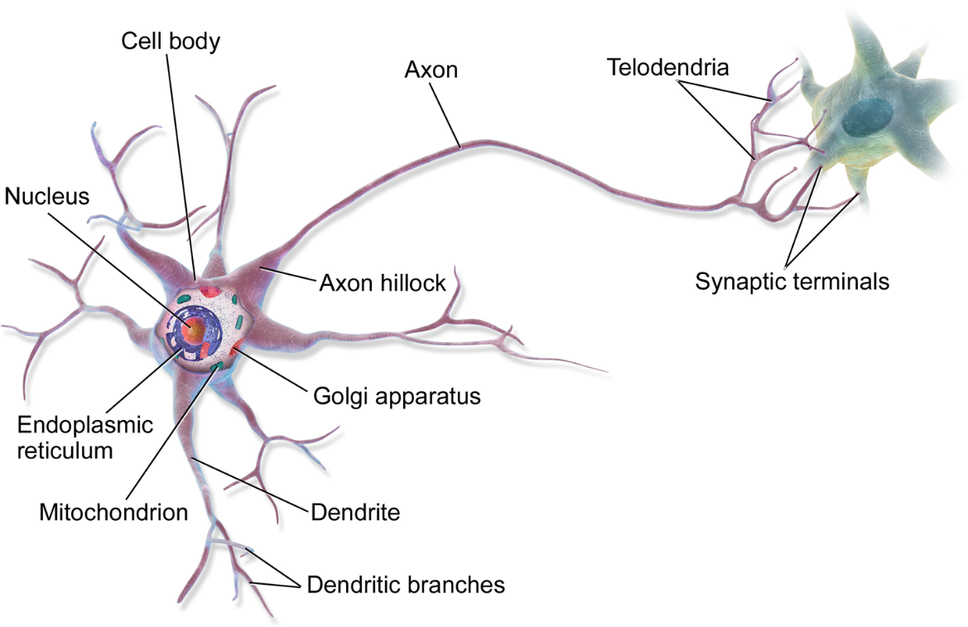
Neural Networks: Lessons From Biology Neurons

Slide 11
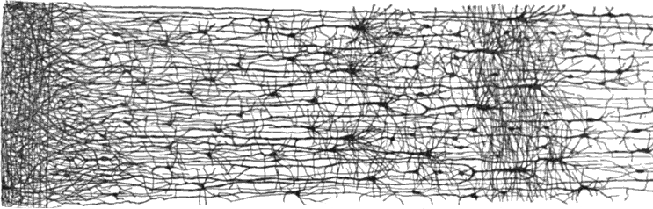
Lessons From Biology: Layers of Neurons

Slide 12
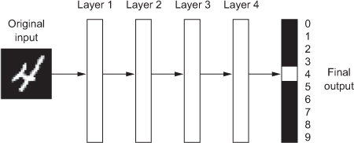
Examples

Slide 13
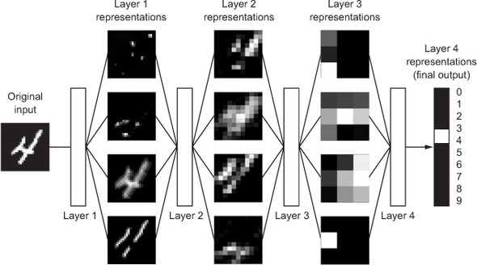
Another Example

Slide 14
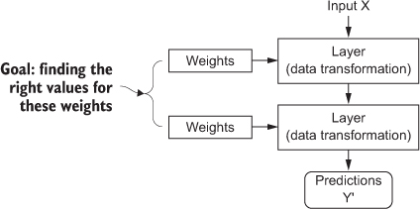
The Weights

Slide 15
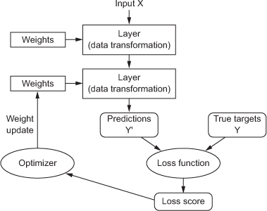
The Loss Function: The Learning Process

Slide 16
Important Parameters
To perform training and testing, we need to decide on three important parameters:
A loss function— How the network will be able to measure its performance on the training data, and thus how it will be able to steer itself in the right direction.
An optimizer— The mechanism through which the network will update itself based on the data it sees and its loss function.
Metrics to monitor during training and testing— Here, we’ll only care about accuracy (the fraction of the images that were correctly classified).

Slide 17
Training and Deploying the Model:
The deep learning process consists of three steps:
Training the model using the training portion of the data set
Test the model using the testing portion of the data set
Save the trained model
Deploy the saved model to perform real tasks

